Slide 1
Diabetic Retinopathy Detection & Grading Using Retinal Fundus Images
Department of Computer Science and Engineering, IIT(ISM) Dhanbad -By Group AKP – 2 Deeksha Sharma (17JE00) Mayank Jain (17JE002935) Yashasvi Gour (17JE002959) Under the supervision of
Dr. Arup Kumar Pal (Asst. Professor) Dept. of Comp. Sc. & Engg. IIT (ISM) Dhanbad

Slide 2
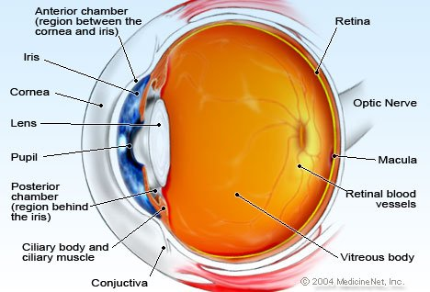
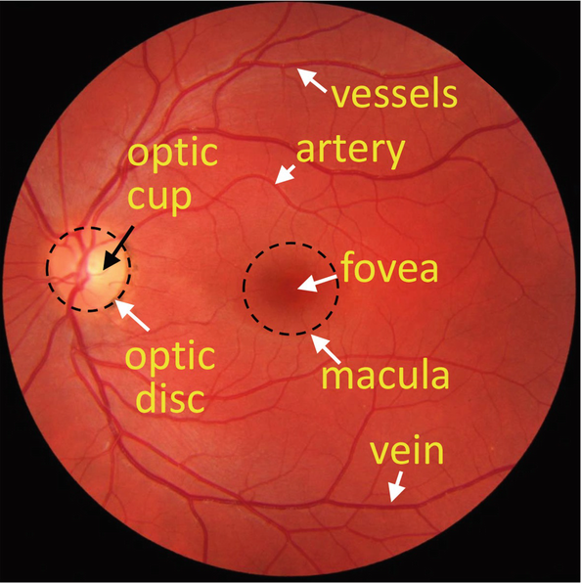
Retinal Fundus
Anatomy of Eye
What is retinal fundus image?
Retinal fundus is the interior lining of the eyeball including retina, optic disc and macula.
Retinal fundus images are obtained by photographing rear of the eye. An example of retinal fundus image is shown below:
A retinal fundus image

Slide 3
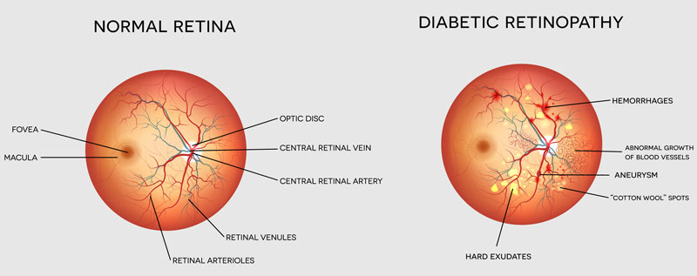
Diabetic Retinopathy
People with diabetes can have an eye disease called diabetic retinopathy. This is when high blood sugar levels cause damage to blood vessels in the retina. These blood vessels can swell and leak. Or they can close, stopping blood from passing through. Sometimes abnormal new blood vessels grow on the retina. All of these changes can steal your vision.
Diabetic retinopathy (DR) is one of the main causes of blindness among the working-age population

Slide 4
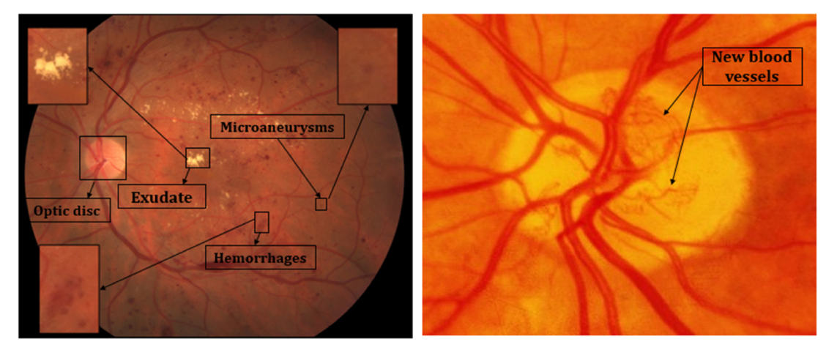
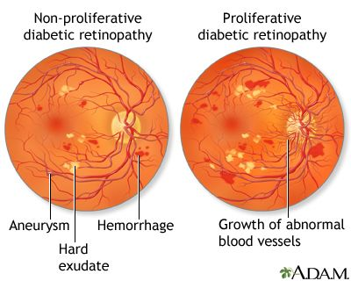
Diabetic Retinopathy(DR) Features
Types of lesions:
Micro-Aneurysms(MA): Less than 125um, red spots with sharp margins
Hemorrhages: Similar to MAs nut larger and irregular margins.
Exudates: Yellowish in color with irregular shape.
Hard: White-yellowish with sharp margins
Soft: Small, whitish-grey cotton like spots
Venous Beading: Growth of new blood vessel routes
Types of DR:
Non- Proliferate(NPDR)
Proliferate(PDR)

Slide 5
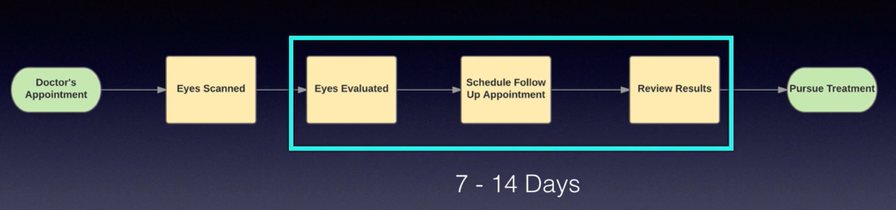
Current Diagnosis Process
Examination and screening of the retina by ophthalmoscopy usually a skilled examiner and a visit to an eye care provider such as optometrist to grade and classify pathology
Grading is an intensive procedure that needs a trained workforce and an adequately sized computer screens
Lack of skilled clinicians and equipment make diagnosis a more tedious and long process.

Slide 6
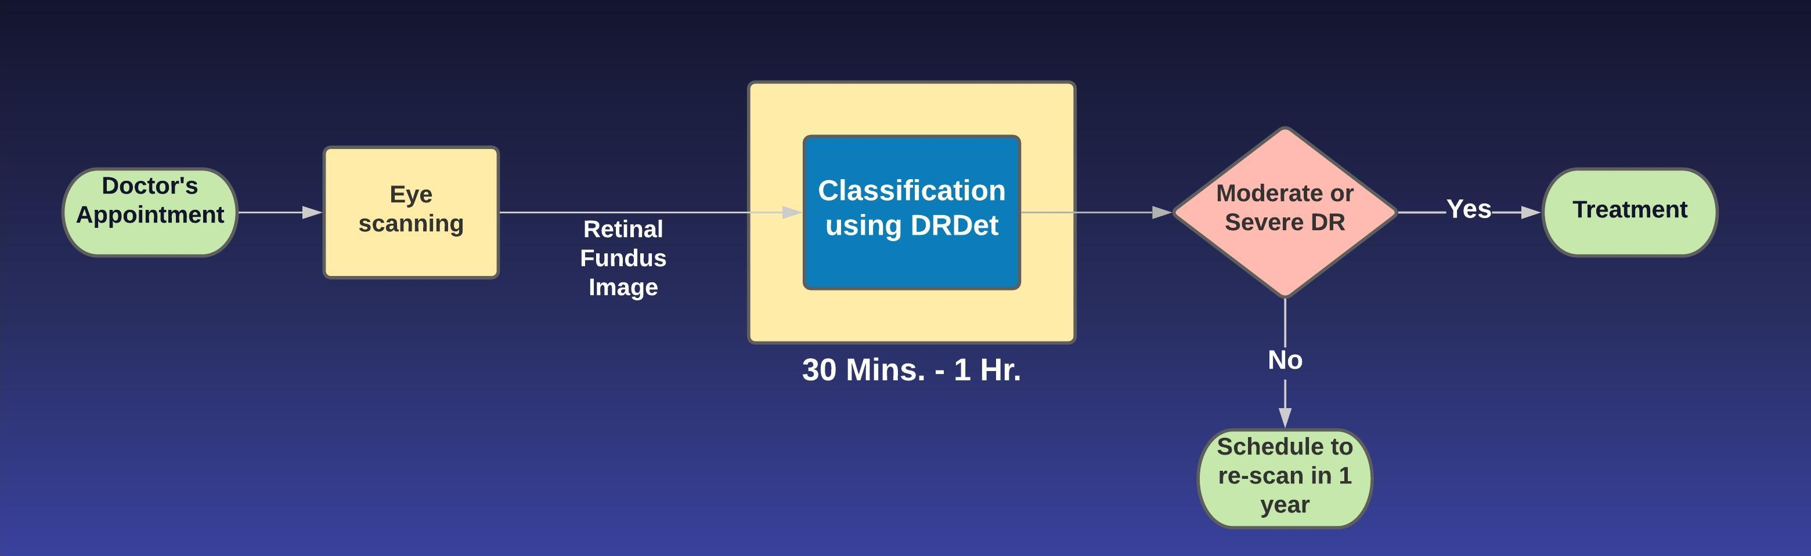
Proposed Diagnosis Process
DRDet will reduce long durations taken by skilled examiners (due to multiple image handling) tremendously.
DRDet reduces the cost for testing and also pathologies with no examiners can still generate reports.

Slide 7
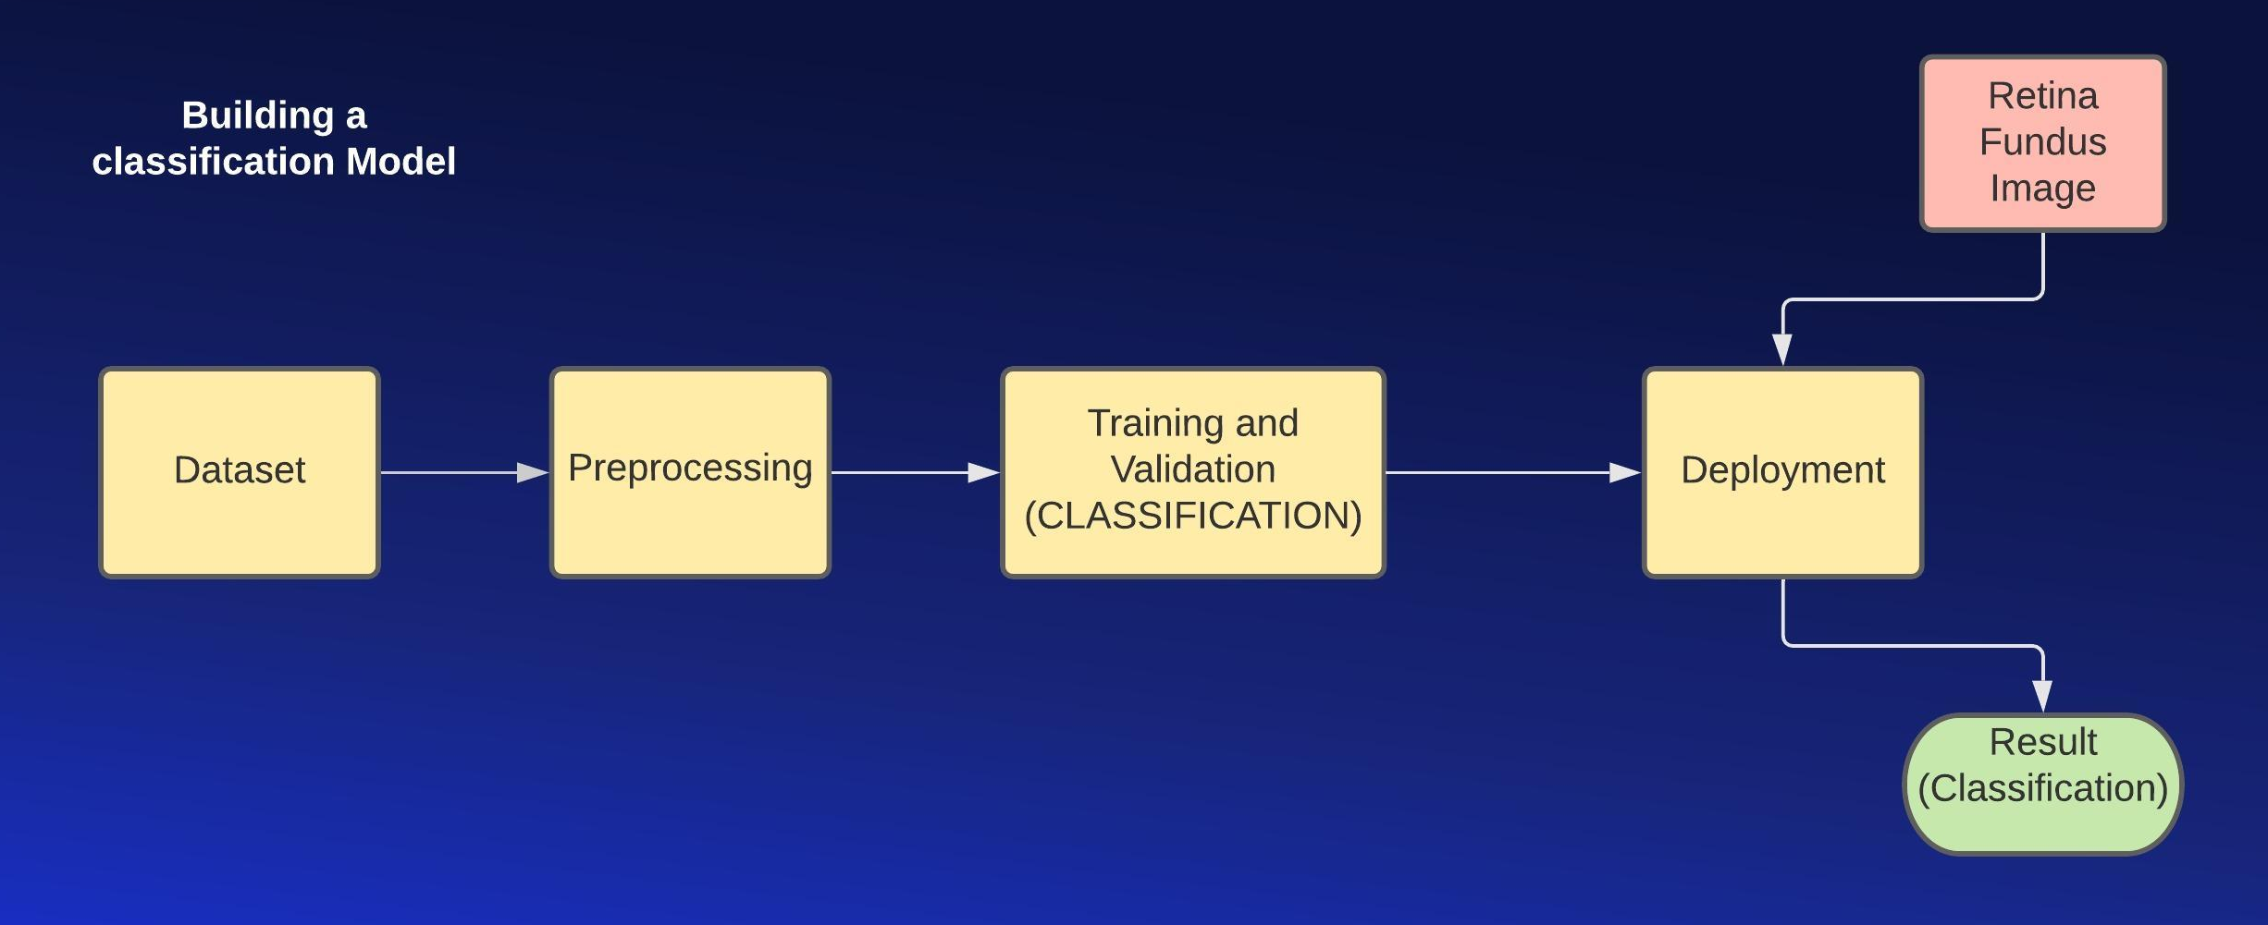
Steps – Classification Model

Slide 8
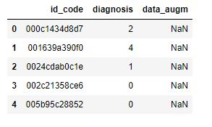
Dataset – Classification Model
Dataset has been extracted from Kaggle. Kaggle Dataset. https://www.kaggle.com/c/aptos2019-blindness-detection/data
It has a large set of high-resolution retina images taken under a variety of imaging conditions.
A clinician has rated the presence of diabetic retinopathy in each image on a scale of 0 to 4, according to the following scale:
0 - No DR 1 - Mild 2 - Moderate 3 - Severe 4 - Proliferative DR
Dataset contains around 3662 images.
Description of dataset
Id_code: Name of the image
Diagnosis: Labeled scale (0-4) for the image
Data_augm: Path to the image generated during data augmentation. Id_code will be NaN here.

Slide 9
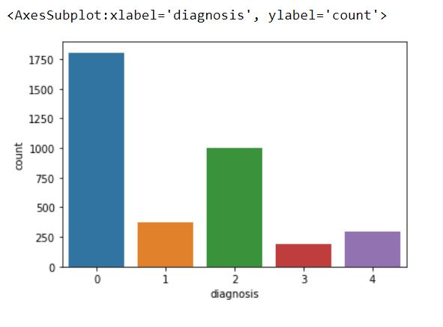
Preprocessing – Classification Model
Data set has a high volume of images with no DR in them, i.e. with label 0.
This causes a high imbalance in the data set causing class imbalance problem.
We generated images using data augmentation for each of the class. Data augmentation techniques mostly use geometric transformations and only create rotated and scaled samples, and do not introduce samples with lesions having morphological variations.

Slide 10
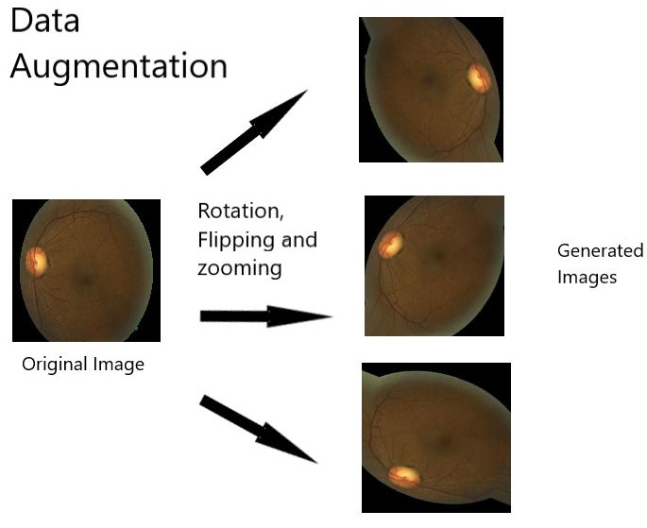
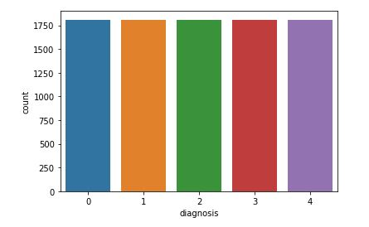
Preprocessing – Classification Model
Data augmentation helps to fix class imbalance problem with around 1800 images in each class

Slide 11
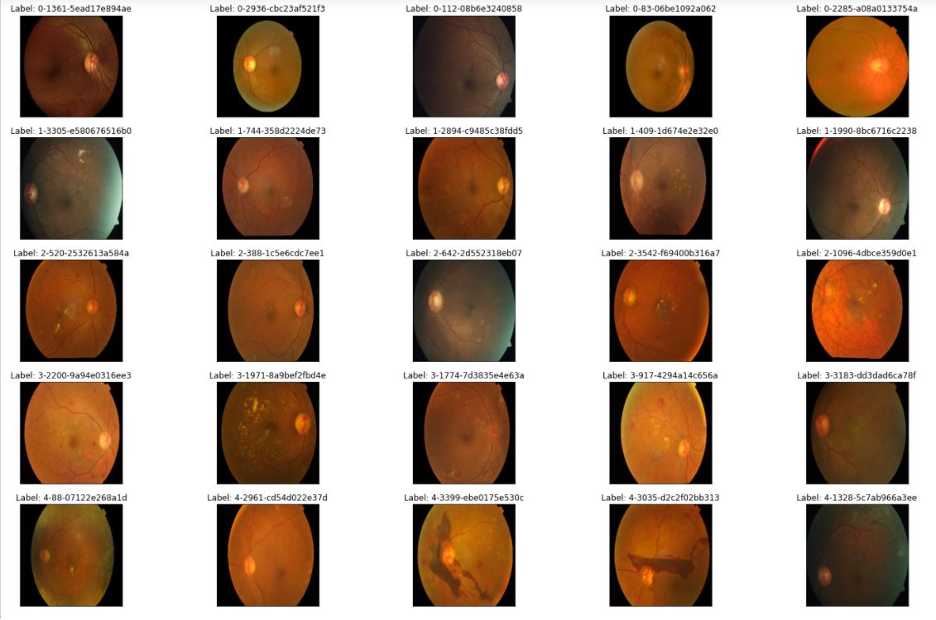
Preprocessing – Classification Model (Image Processing)
Original Input Images looked as follows:
We can see two problems which make the severity difficult to spot on.
First, some images are very dark [pic(0,2) and pic(4,4) ] and sometimes different color illumination is confusing [pic (3,3)].
Second, we can get the uninformative dark areas for some pictures [pic(0,1), pic(0,3)]. This is important when we reduce the picture size, as informative areas become too small. So it is intuitive to crop the uninformative areas out in the second case.

Slide 12
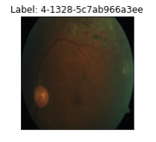
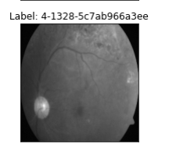
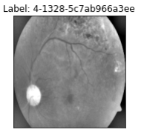
Preprocessing – Classification Model (Image Processing)
To grayscale
Improving light conditions
We can try gray scale and understand better for some pictures, as color distraction is gone. For example, we can see more blood clearer in the upper part of pic above which has severity of level 4.
We can blend the image with its gaussian blurred image with weights as 4 and -4

Slide 13
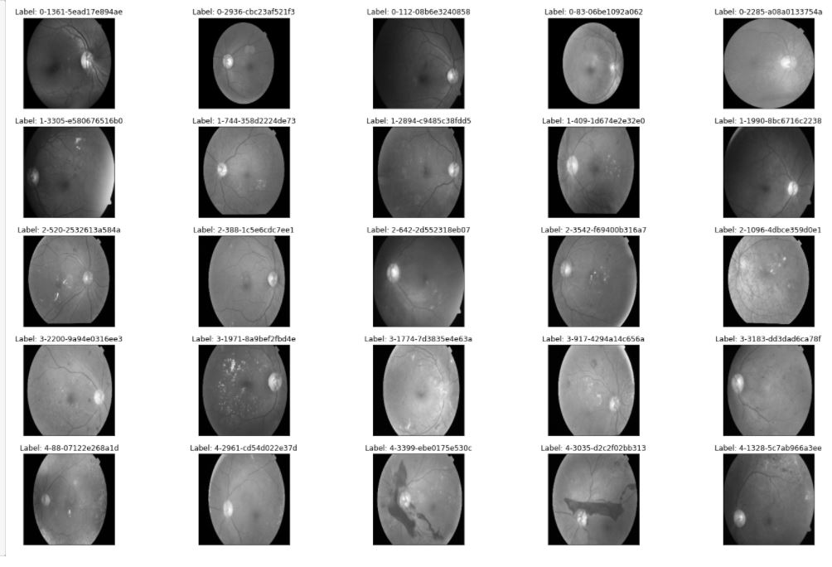
Preprocessing – Classification Model (Image Processing)

Slide 14
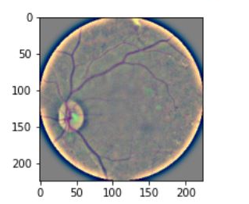
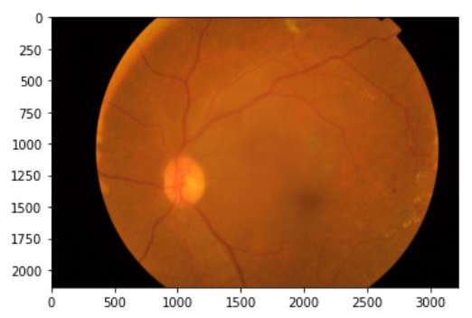
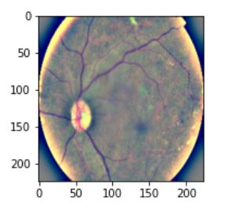
Preprocessing – Classification Model (Image Processing)
We can further improve the preprocessing process by auto-cropping / circle-cropping (around the center of the image) the images to remove unwanted black borders.
Also colored images with light blending gave better results. So we applied light blending with auto cropping / circle-cropping on colored images itself.
Circle cropped image
Auto cropped image
Original Image

Slide 15
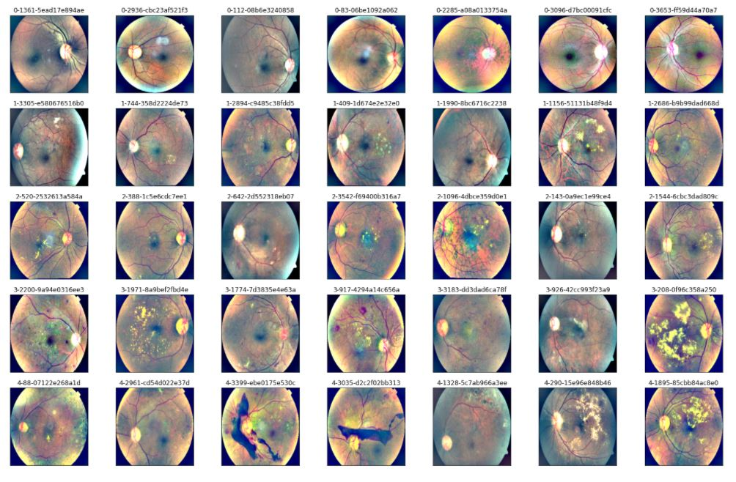
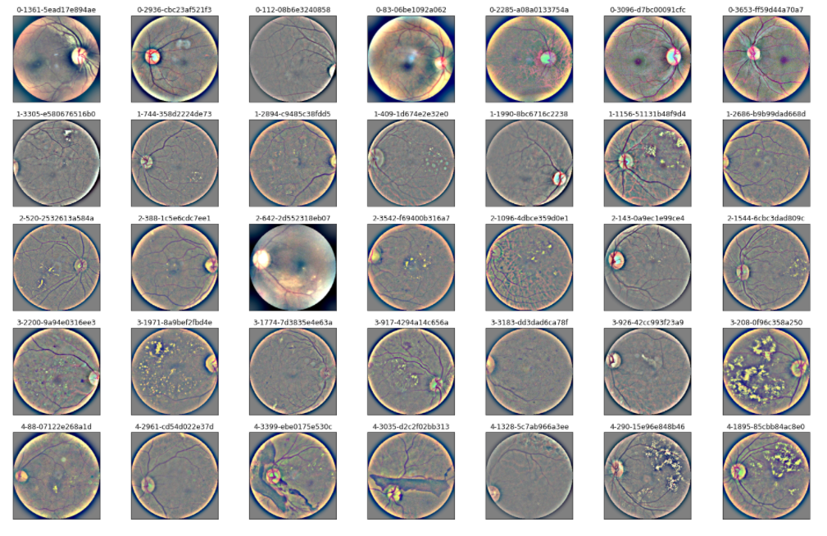
Preprocessing – Classification Model (Image Processing)
Auto-cropped data
Circle-cropped data
Finally we are left with dataset as shown above which will be used to train the model.

Slide 16
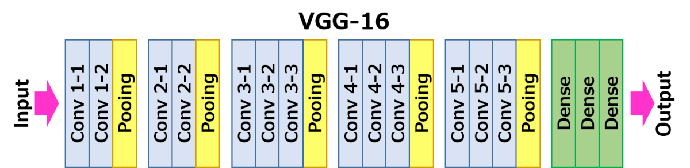
Model Training – VGG16
VGG16 is a convolutional neural network model proposed by K. Simonyan and A. Zisserman from the University of Oxford in the paper “Very Deep Convolutional Networks for Large-Scale Image Recognition”. The model achieves 92.7% top-5 test accuracy in ImageNet, which is a dataset of over 14 million images belonging to 1000 classes
We use pre-trained VGG16 model to save enormous computational power and time required to train a model. Also since the data in medical field is not much it is better to use a pre-trained model.

Slide 17
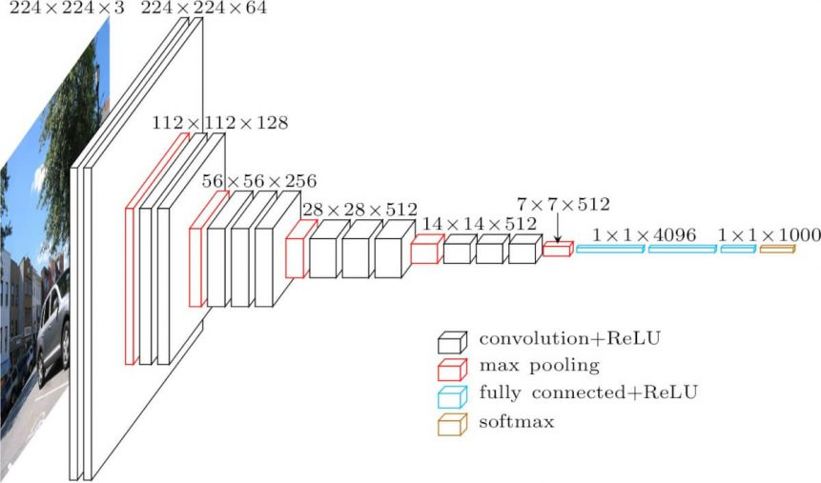
Model Training – VGG16
The detailed architecture of VGG16 is as follows:

Slide 18
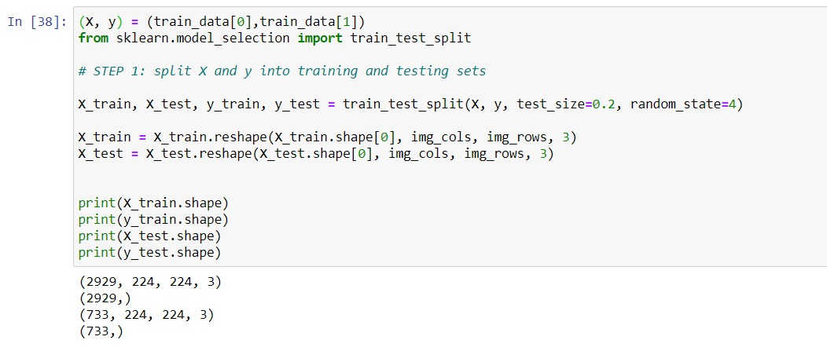
Model Training – VGG16 – Steps
For VGG16 we followed following rules to get a baseline model:
NO DATA AUGMENTATION was performed
NO Image processing was performed
Dataset division:

Slide 19
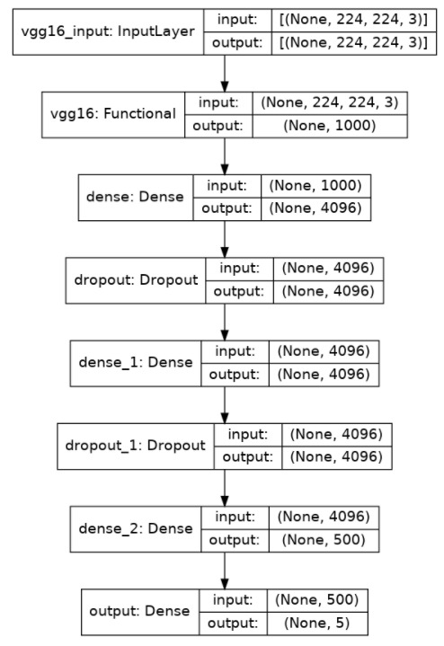
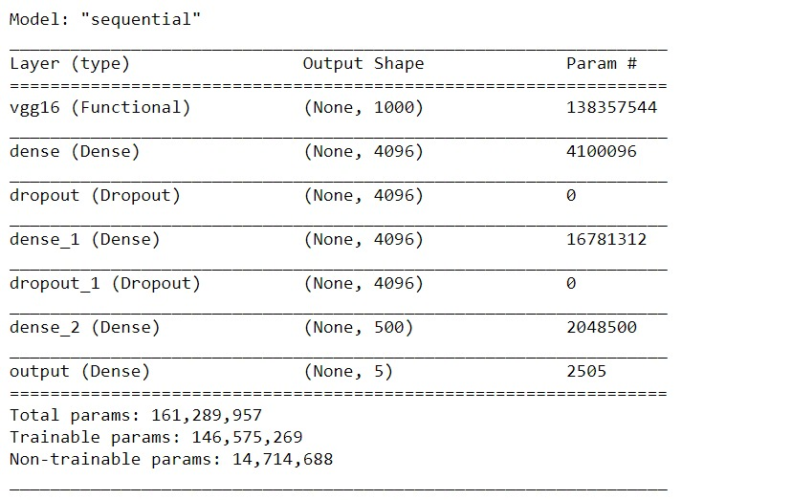
Model Training (VGG16) – Steps
Our model architecture is shown in the figure
We add six new layers after the base VGG16 model for fine tuning.

Slide 20
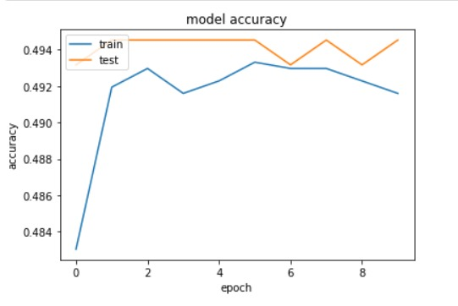
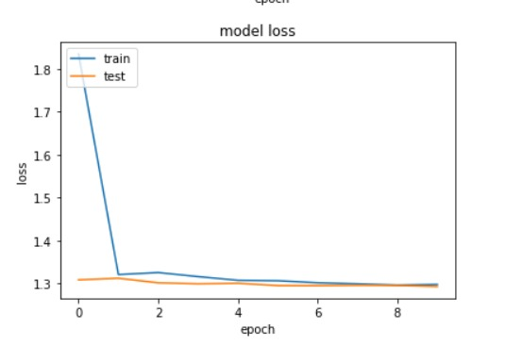
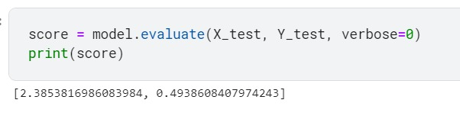
Model Training – VGG16 – Result
Now the model is trained on 224x224 preprocessed fundus images for 20 epochs.
Finally the model is saved and is run with test images. Final results are:
The results obtained on training the model using VGG16 as our base model, we obtained a low accuracy of about 50% on test set

Slide 21
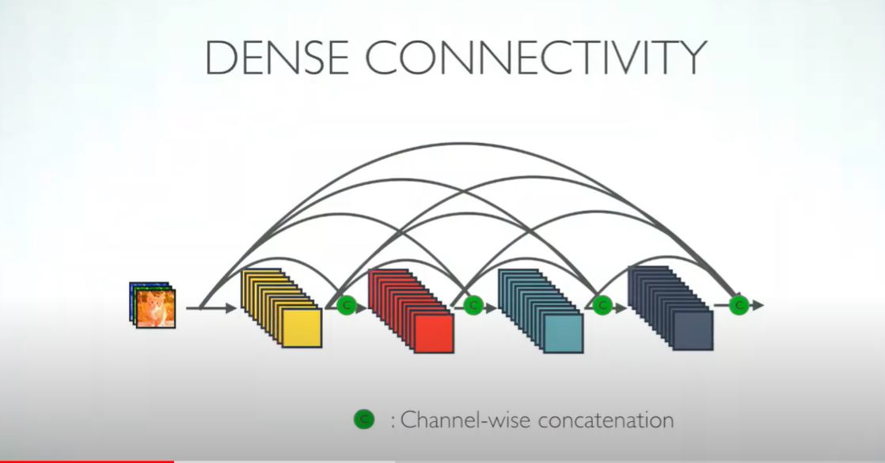
Model Training - DenseNet
We train a Dense Neural Network to predict the classification labels for retinal fundus images.
We use pre-trained DenseNet121 model to save enormous computational power and time required to train a model. Also since the data in medical field is not much it is better to use a pre-trained model.
In DenseNets, to improve the information flow between layers it has a different connectivity pattern: direct connections from any layer to all subsequent layers
The DenseNet has different versions, like DenseNet-121, DenseNet-160, DenseNet-201, etc. The numbers denote the number of layers in the neural network.

Slide 22
Model Training – DenseNet121
The number 121 is computed as follows:

Slide 23
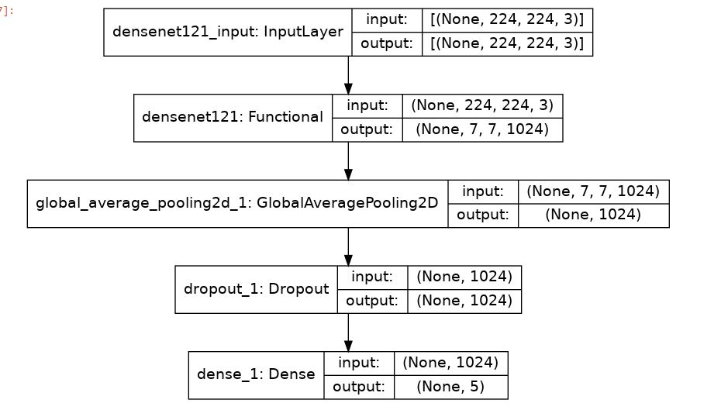
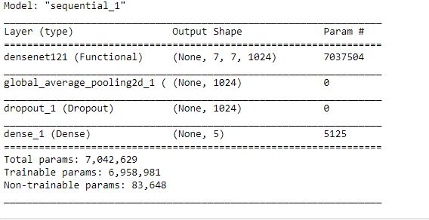
Model Training – DenseNet121 – Steps
For DenseNet121 we trained the model three times with three different scenarios:
For 1st training we applied Light blending + Circle Crop (Image preprocessing)
For 2nd training we applied Light blending + Auto Crop (Image preprocessing)
For 3rd training we applied Light blending + Auto Crop + Data Augmentation (Light blending + Auto crop gave better results in previous two trainings.)
We construct our model by first taking an empty neural network and adding densenet121 base model to it and then adding three more layers to it.

Slide 24
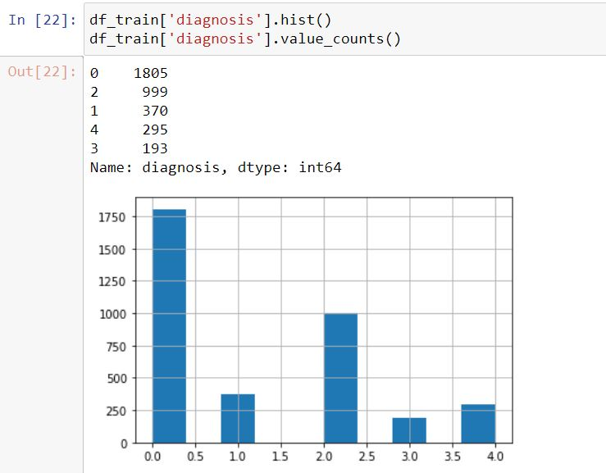
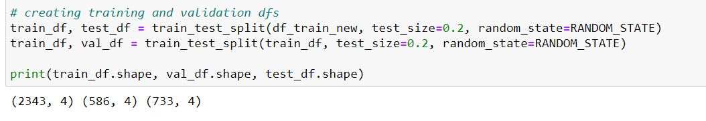
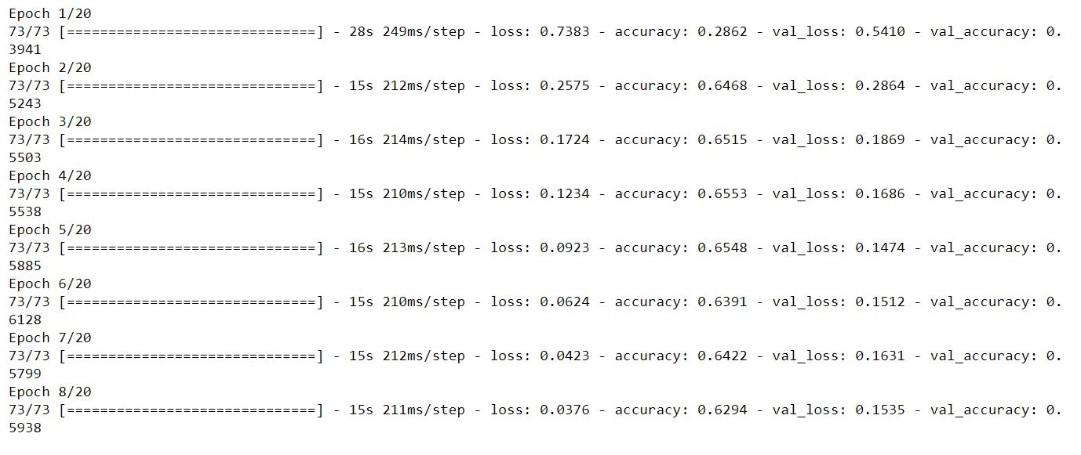
Model Training – DenseNet121 – Light Blending + Circle Crop
Data Splitting:
Now the model is trained on 224x224 preprocessed fundus images for 8 epochs
Finally the model is saved and is run with test images. Final results are shown in next slide.

Slide 25
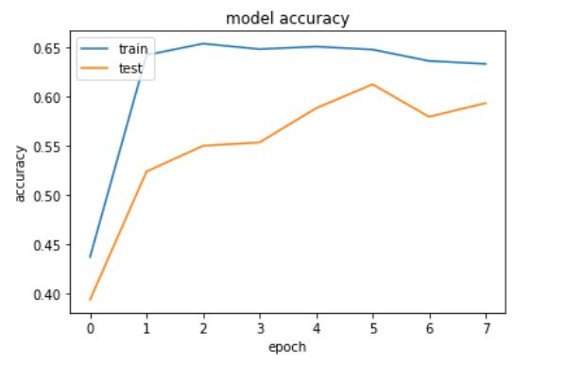
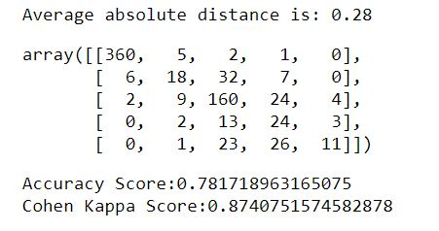
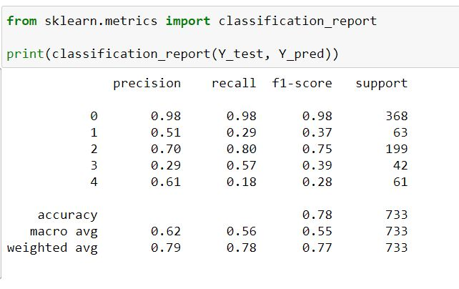
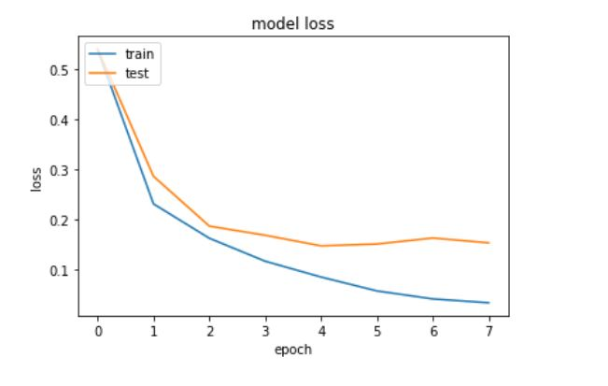
Analysis And Result - DenseNet121 – Light Blending + Circle Crop

Slide 26
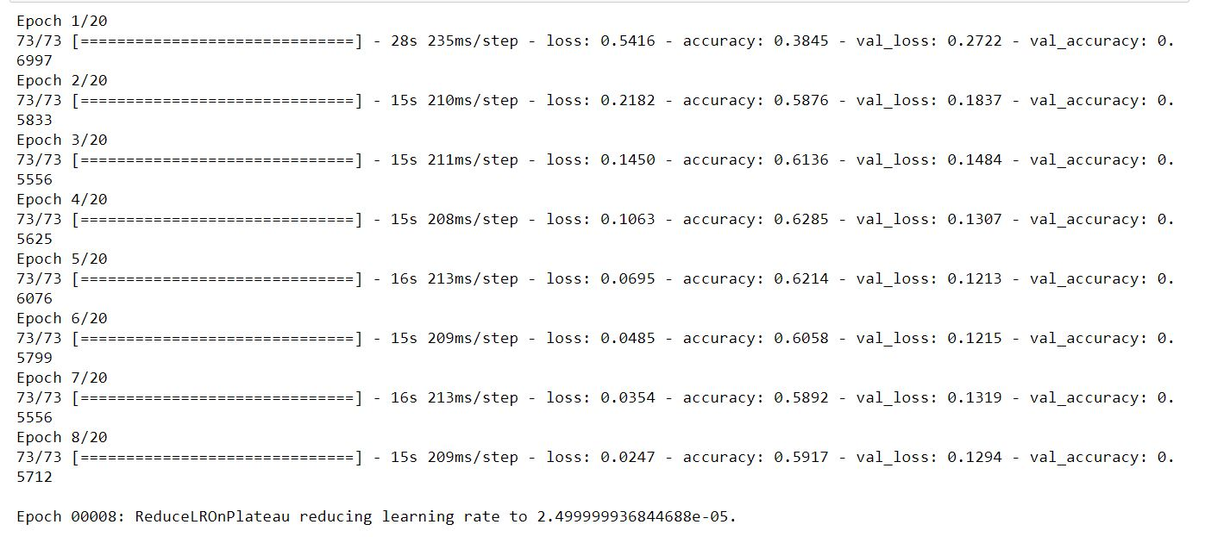
Model Training – DenseNet121 – Light Blending + Auto Crop
Data Splitting:
Now the model is trained on 224x224 preprocessed fundus images for 8 epochs
Finally the model is saved and is run with test images. Final results are shown in next slide.

Slide 27
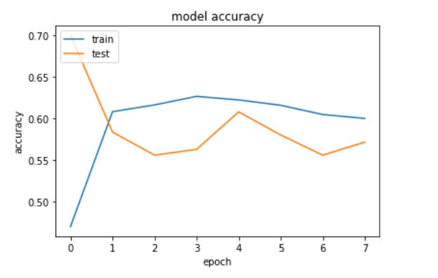
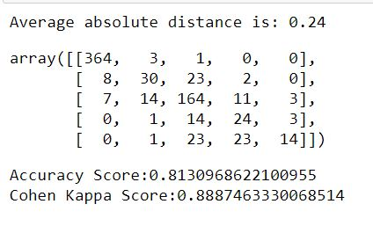
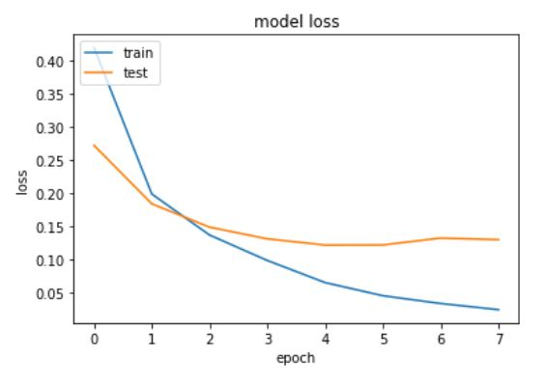
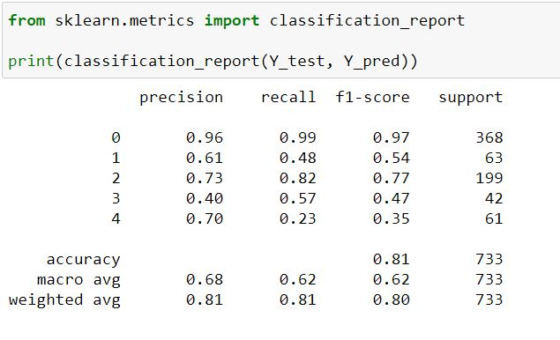
Analysis And Result - DenseNet121 – Light Blending + Auto Crop

Slide 28
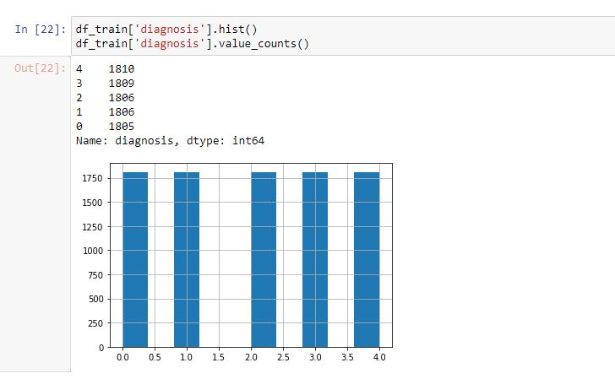
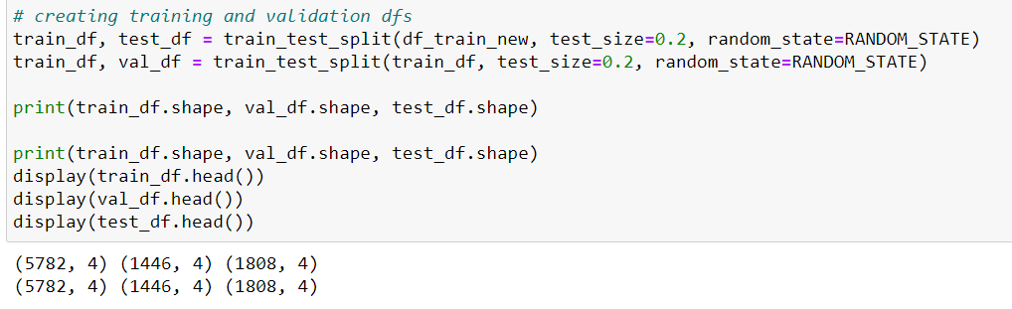
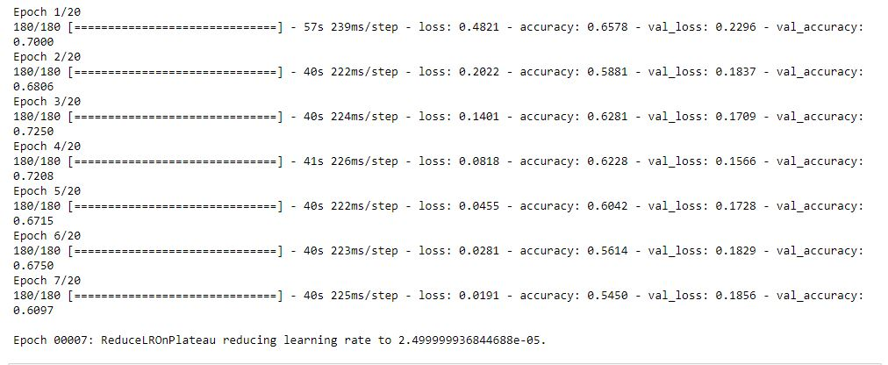
Model Training – DenseNet121 – Light Blending + Auto Crop + DATA AUGMENTATION
Data Splitting:
Now the model is trained on 224x224 preprocessed fundus images for 7 epochs
Finally the model is saved and is run with test images. Final results are shown in next slide.

Slide 29
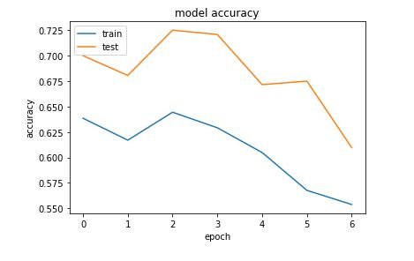
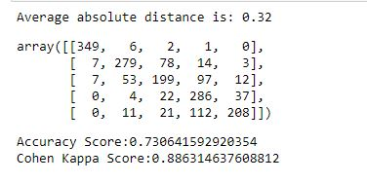


Analysis And Result - DenseNet121 – Light Blending + Auto Crop + Data Augmentation

Slide 30
Analysis And Conclusion
MODEL | ACCURACY SCORE | COHEN KAPPA SCORE | Conclusion
VGG16 | 0.4938 | 0.57 | Performance is low for every class
DenseNet121 Light blending + Circle Crop | 0.7817 | 0.8740 | Performs well on class 0,2. Low performance on other classes
DenseNet121 Light blending + Auto Crop | 0.8130 | 0.8887 | Performs well on class 0,2. Low performance on other classes
DenseNet121 Light blending + Auto Crop + Data Augmentation | 0.73 | 0.88 | Performs well on all classes especially 0,1,2,3. Average performance on class 4

Slide 31
FUTURE WORK
Image size is also a great factor in image processing in this problem statement, as we take bigger picture we are able to see eye deformities clearly in the image than in the smaller image. Due to lack of high end resources the image size was restricted to 224 * 224 w.r.t. width and height. But with more powerful GPUs we can try to train the model with higher image sizes to achieve better result.
Deploy this model on a website.

Slide 32
REFERENCES
[1] Deep learning frameworks for diabetic retinopathy detection with smartphone-based retinal imaging systems
[2] Diagnostic assessment of deep learning algorithms for diabetic retinopathy screening
[3] https://arxiv.org/pdf/1608.06993v3.pdf
[4] https://www.pluralsight.com/guides/introduction-to-densenet-with-tensorflow
[5] https://www.kaggle.com/c/diabetic-retinopathy-detection/data

Slide 33
Thank You

